Slide 1
Basic Electrical Engineering BEEE101L

Slide 2
Module 6 Electrical Supply Systems & Safety
Concepts of electrical power generation, transmission and distribution systems;
Wiring;
Electrical safety;
Earthing;
Protective devices

Slide 3
Electrical safety – insulation and fuses
Insulation is used to prevent ‘leakage’, and when determining what type of insulation should be used, the maximum voltage present must be taken into account.
For this reason, peak values are always considered when choosing insulation materials.
Fuses are the weak link in a circuit and are used to break the circuit if excessive current is drawn. Excessive current could lead to a fire.
Fuses rely on the heating effect of the current, and for this reason, r.m.s values must always be used when calculating the appropriate fuse size.

Slide 4
Protective
Device
Help to ensure safe and healthy working conditions
Prevents damage to an electrical system.
Protect from the risk of injury.
It include circuit breaker and fuse.

Slide 5
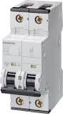
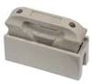
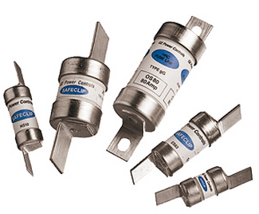
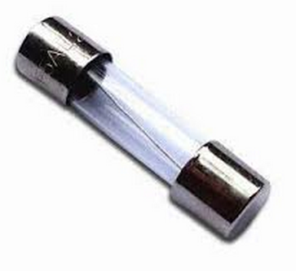
Protective Devices
Fuses
Circuit Breakers
FUSE
LOW VOLTAGE FUSE
REWIREABLE
CARTRIDGE
HIGH VOLTAGE FUSE
Miniature Circuit Breaker

Slide 6
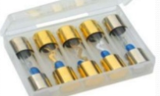
Fuses
It is a current interrupting device which breaks the circuit by fusing the element when current in the circuit exceeds certain value.
Fuse consist of two main parts:
Fuse casing
Fuse elements
Fuse casing may be made up of:
Ceramics
Glass
Plastic
Molded mica laminates

Slide 7
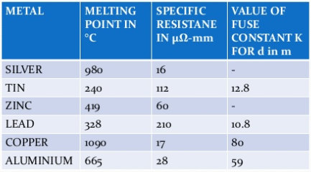
Fuse Element Material
The materials used for fuse elements must be of low melting point , low ohmic loss ,high conductivity , low cost & free from deterioration.

Slide 8
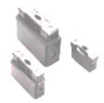
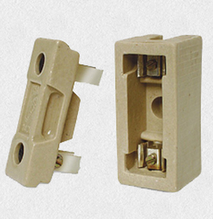
Rewireable Type
(Semi Enclosed Type or Kit-Kat Type)
This kind of fuse is most commonly used in the case of domestic wiring and small scale usage.
The main advantage of this type of fuse is that it is easy to install and also replace without risking any electrical injury. But there are certain shortcomings associated with it too.
Disadvantages:
Unreliable Operation
Lack Of Discrimination
Low Rupturing Capacity
No-Current-Limiting Features
Slow Speed Of Operation
Risk Of Flame & Fire

Slide 9
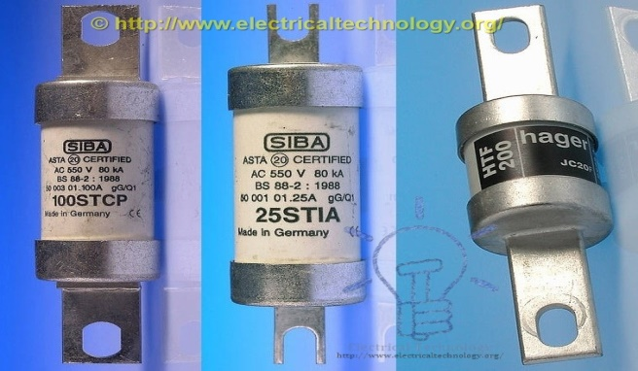
Cartridge Type
(Totally Enclosed Type)
The fuse element is totally enclosed in an enclosed container, and it has metal contacts on both sides
The level of sub division in this case includes:
1.D type
2.Link Type or High Rupturing Capacity

Slide 10
Link Type or High Rupturing Capacity
In such type of fuses, the fuse element carries the fault current for a long duration. If the fault is not clear, then the fuse element will melt and open the circuit. The major advantage of HRC fuse is that it clears the low as well as a high fault current.
HRC fuse has the high-speed operation and also does not require maintenance.
But the fuse element of the HRC fuses needs to be replaced after each operation, and it also produced the heat during the faults which will affect the operations of the nearby switches.

Slide 11
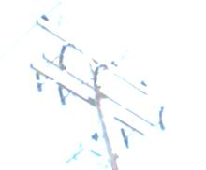
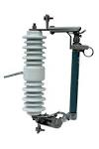
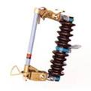
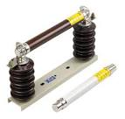
High Voltage Fuse
High Voltage (HV) fuses are used in power system to protect the power transformer, distribution transformers and instrument transformer etc where circuit breakers may not be able to protect the system. High Voltage fuses are rated for more than 1500V and up to 13kV.

Slide 12
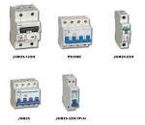
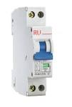
Miniature circuit breaker (MCB)
A circuit breaker is a manually or automatically operated electric switch designed to protect an electrical circuit from damage caused by overload or short circuit.
MCB automatically switches off the electrical circuit during abnormal condition of the network means in over load condition as well as faulty condition.
MCB is much more sensitive to over current than fuse.

Slide 13
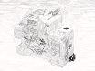
Advantages
1. It automatically switches off the electrical circuit during abnormal condition of the network means in over load condition as well as faulty condition.
2. Handling MCB is more electrically safe than fuse.
3. Another advantage is, as the switch operating knob comes at its off position during tripping, the faulty zone of the electrical circuit can easily be identified.

Slide 14
Grounding/Earthing

Slide 15
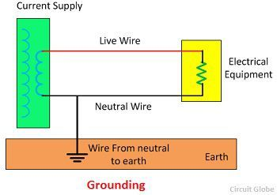
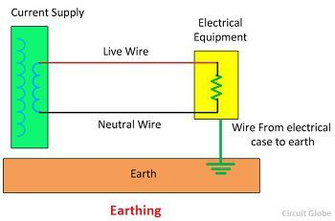
Earthing and Grounding
Earthing and grounding are similar terms. Still, these are having some differences.
The ‘earthing’ means the connection of non-current carrying part of the equipment to the earth. When the fault occurs in the system, then the potential of the non-current part of the equipment raises, and when any human or stray animal touch the body of the equipment, then they may get shocked.
In grounding, the current carrying parts are directly connected to the ground. The grounding provides the return path for the leakage current and hence protect the power system equipment from damage.

Slide 16
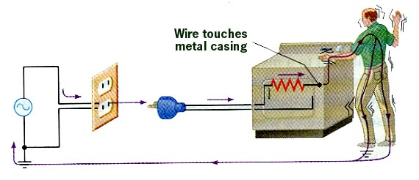
Improperly Grounded Appliance with Short
One milliampere: tingling sensation Ten milliamperes: nerves and muscles overloaded 200 milliamperes: potentially fatal; heart fibrillation 500 -1000 milliamperes: not necessarily fatal; heart will restart
One ampere or more: burn alive

Slide 17
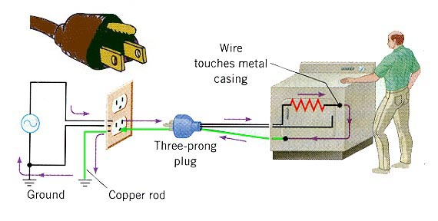

Grounded Appliance

Slide 18
Grounding
The PRIMARY goal of the grounding – SAFETY
PERSONNEL SAFETY
EQUIPMENT PROTECTION

Slide 19
Safety for Human life/ Building/Equipments
To save human life from danger of electrical shock or death by blowing a fuse i.e. To provide an alternative path for the fault current to flow so that it will not endanger the user
To protect buildings, machinery & appliances under fault conditions.
To ensure that all exposed conductive parts do not reach a dangerous potential.
To provide safe path to dissipate lightning and short circuit currents.
To provide stable platform for operation of sensitive electronic equipments i.e. To maintain the voltage at any part of an electrical system at a known value so as to prevent over current or excessive voltage on the appliances or equipment

Slide 20
Over voltage protection
Lightning, line surges or unintentional contact with higher voltage lines can cause dangerously high voltages to the electrical distribution system.
Earthing provides an alternative path around the electrical system to minimize damages in the System

Slide 21
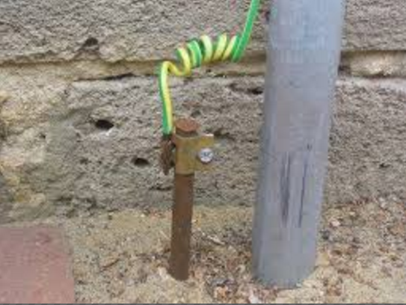

Earthing

Slide 22
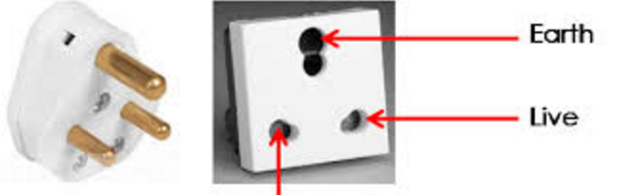
Earthing

Slide 23
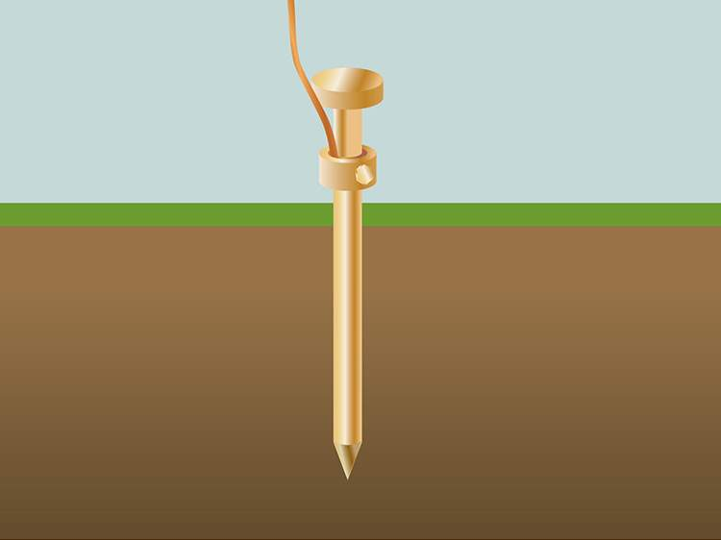
Types of Earthing
Different types available
Choice depends on local conditions and required function
Simplest form is a single stake
Mostly used for:
Lightning protection
Stand alone structures
Back-up for utility ground

Slide 24
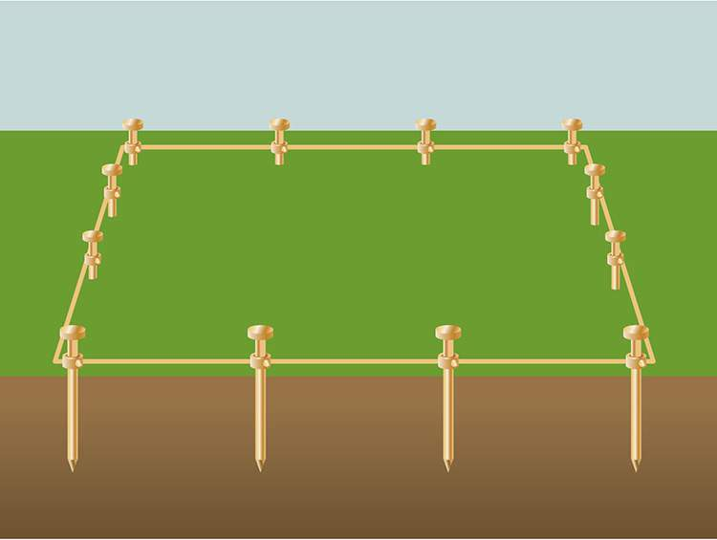
Types of Earthing
Ground rod group
Typically for lightning protection on larger structures or protection around potential hotspots such as substations.

Slide 25
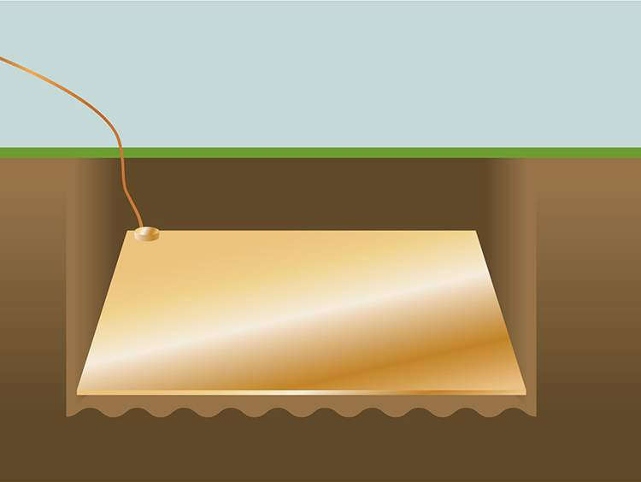
Types of Earthing
For areas where there is rock (or other poor conducting material) fairly close to the surface ground plates are preferred as they are more effective
Ground plate

Slide 26
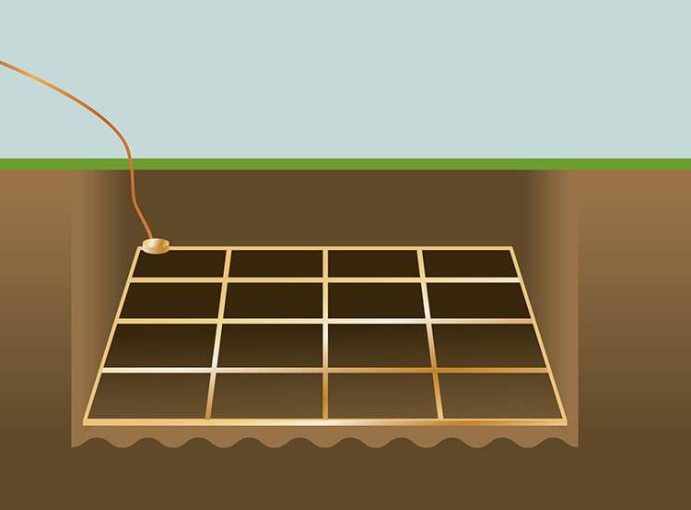
Types of Earthing
Ground mesh
A ground mesh consists of network of bars connected together, this system is often used at larger sites such as electrical substations.

Slide 27
Residential Wiring

Slide 28
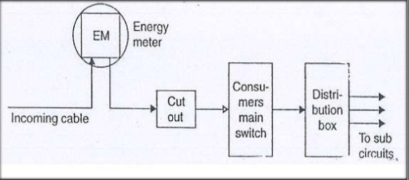
Single line diagram of electrical Installation

Slide 29
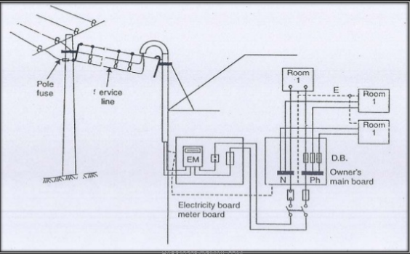
Line Diagram of Service line to Main Switch connection

Slide 30
TYPES Of WIRING
Cleat
Batten
PVC Wiring
TRS/CTS Wiring
Lead Sheath Wiring
Casing Caping
Conduit
Surface Conduit
Metal conduit
P.V.C. conduit
Concealed Conduit
Metal conduit
P.V.C. conduit

Slide 31
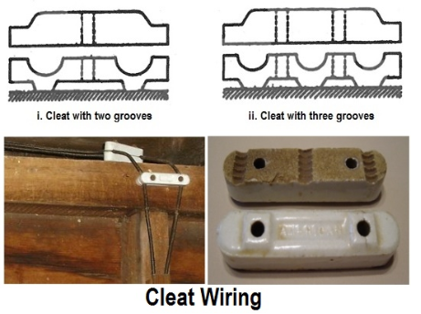
Cleat Wiring

Slide 32
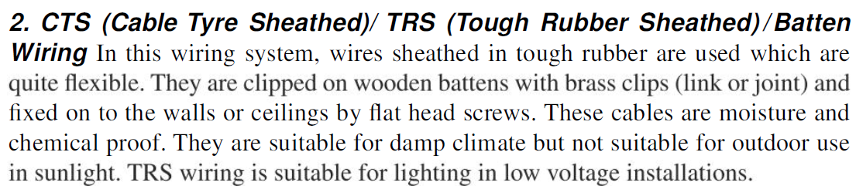
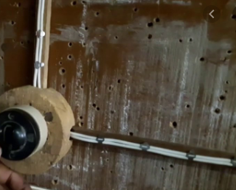
Batten Wiring

Slide 33
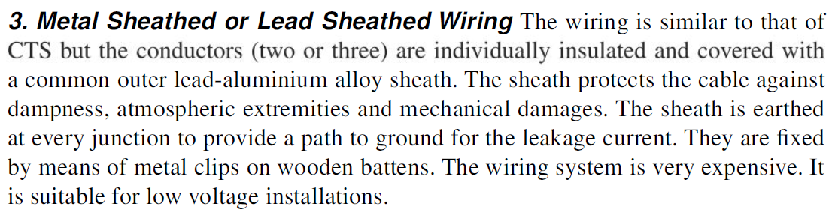
Batten Wiring

Slide 34
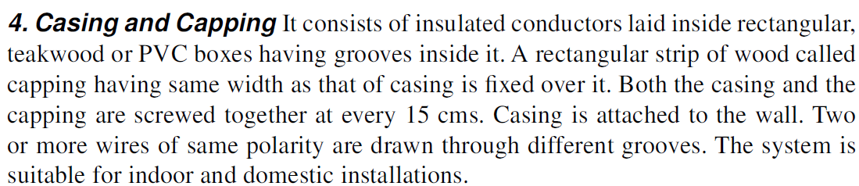
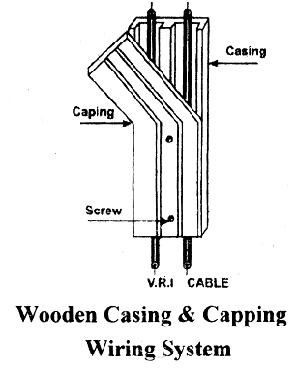
Wooden Casing and Capping Wiring

Slide 35
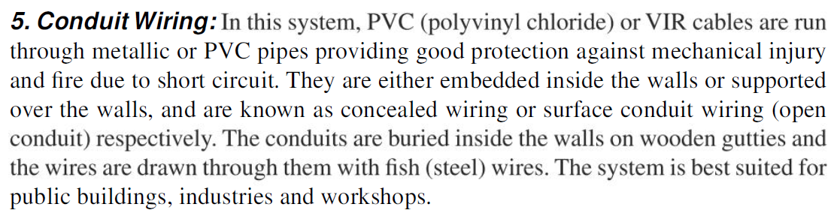
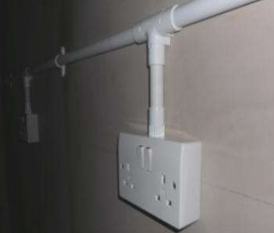
Surface conduit wiring

Slide 36
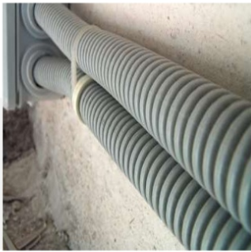
Concealed conduit wiring
PVC, or metallic conduit are used Conduit inside the wall
Appearance is good
Protect against fire dust moisture mechanical damage
Less maintenance
Less chance of Fault
Cost is high

Slide 37
Types of wire used in Residential wiring
Vulcanized Rubber wire
Weather proof wire
Lead covered wire
Mineral insulated copper covered
Poly Vinyl Chloride wire

Slide 38
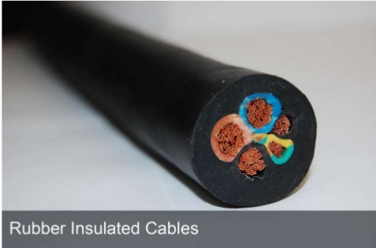
Vulcanized Rubber wire

Slide 39
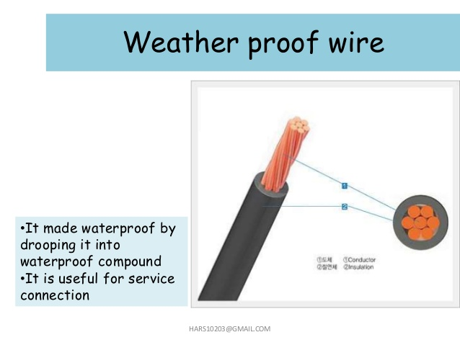

Slide 40
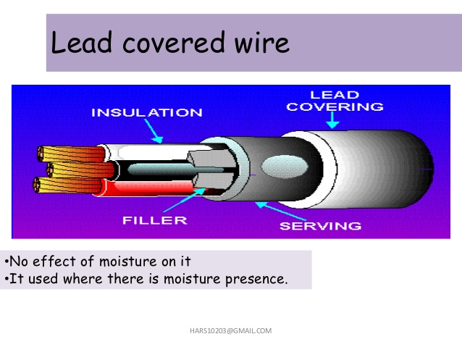

Slide 41
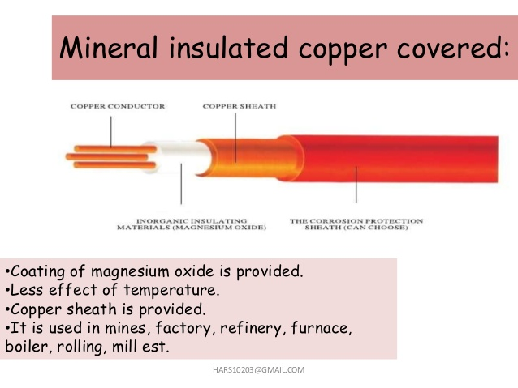

Slide 42
